Slide 1
Welcome to West Croft

Slide 2
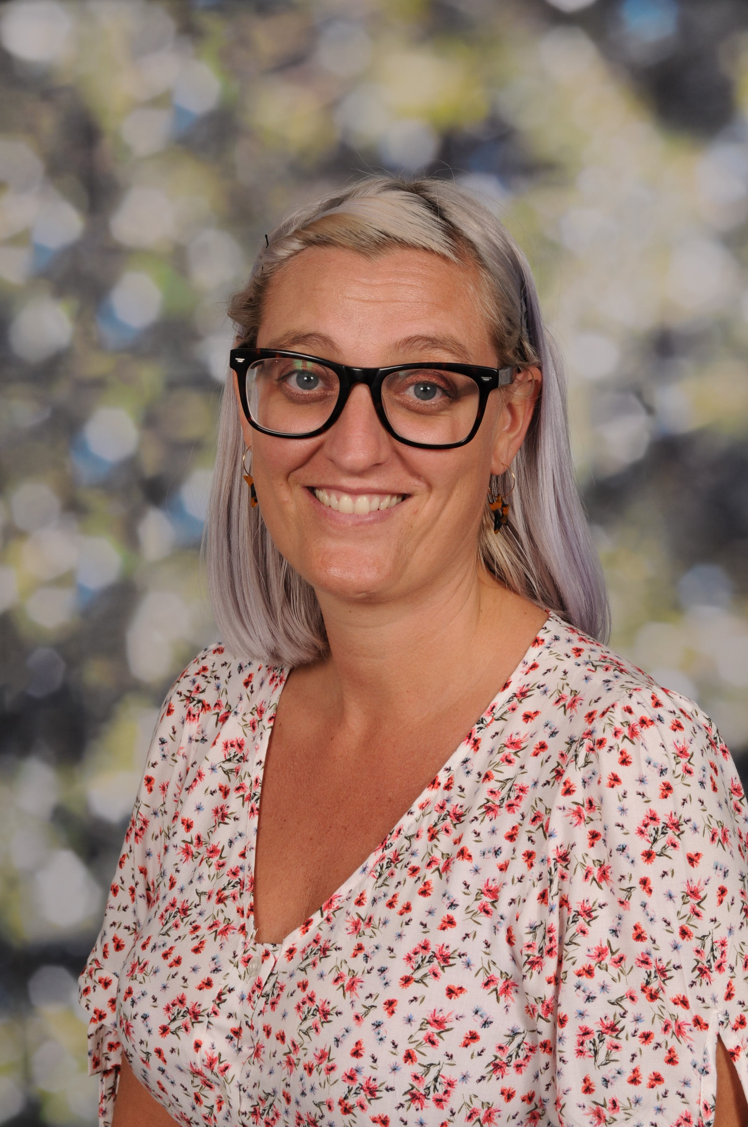
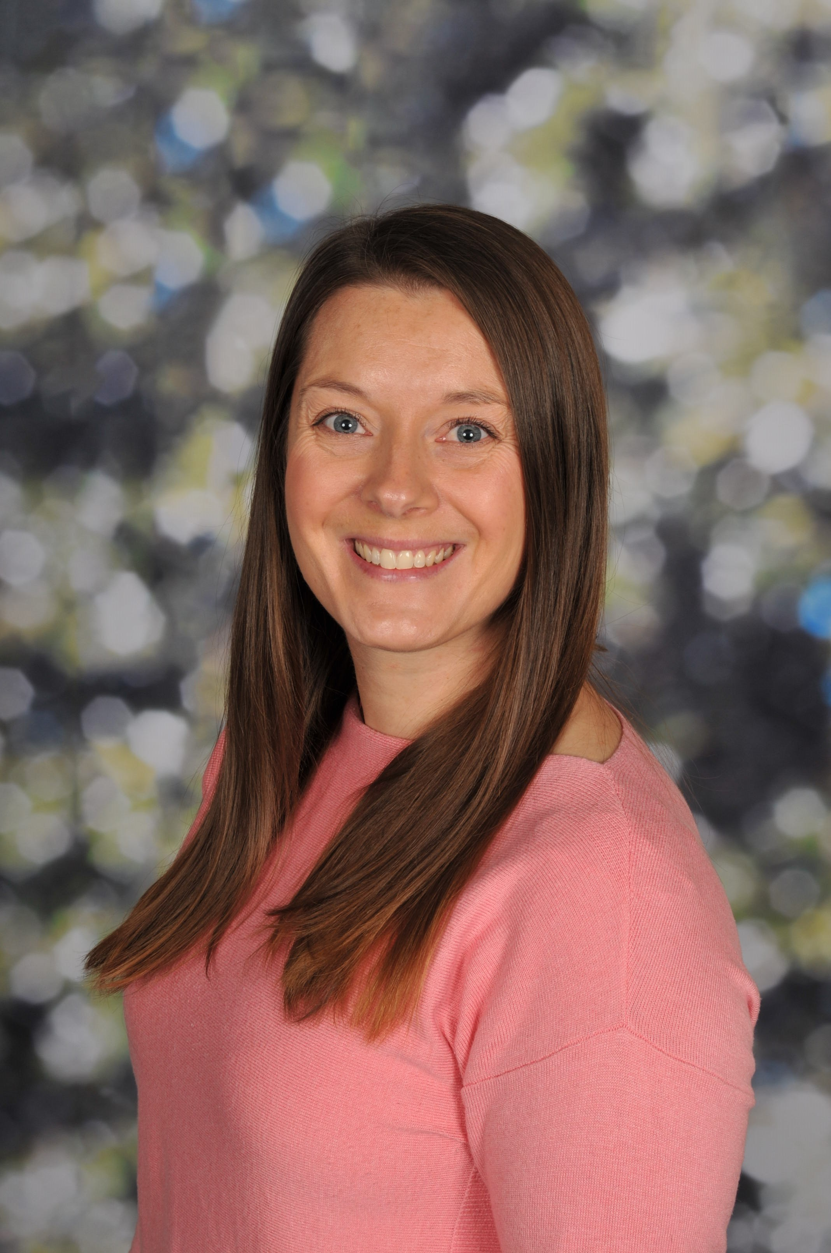
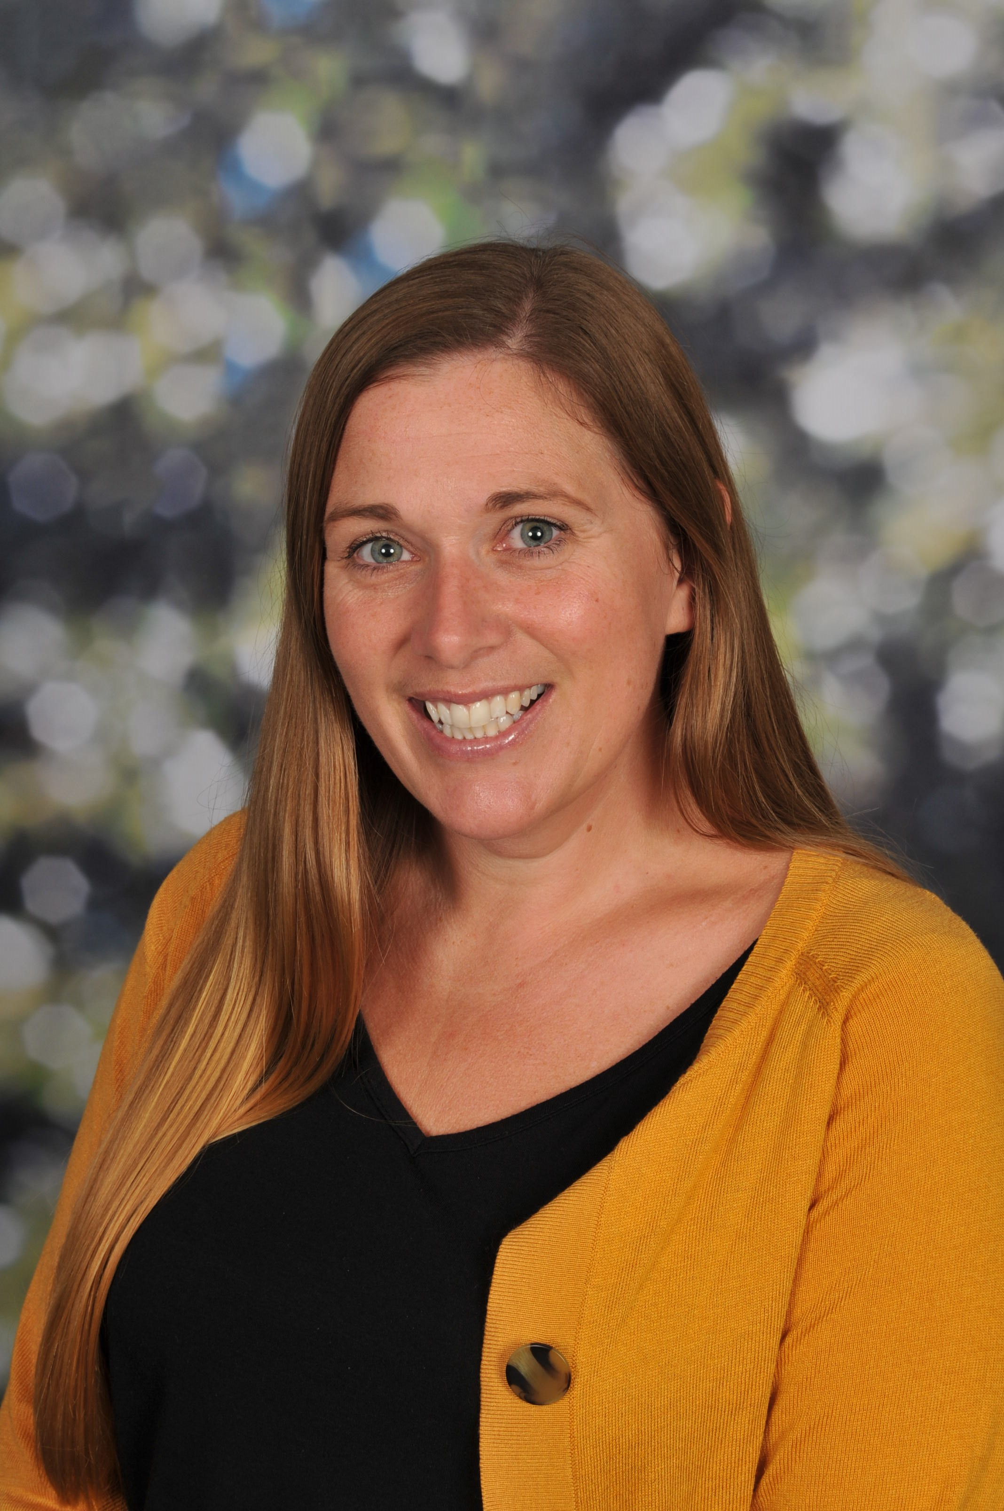
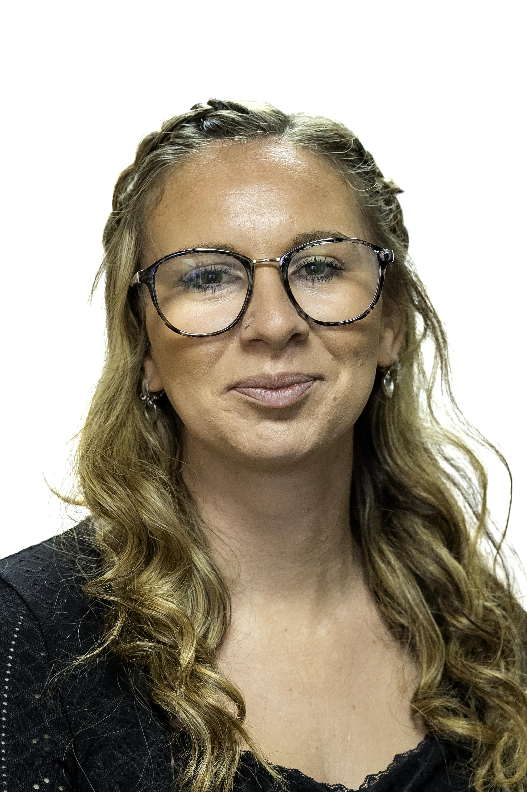
Meet the team
Miss Prowse
Miss Rossiter
Miss Fay
Mrs Jenkin

Slide 3
The school day
Doors open 8:40 - drop at the door
Start learning at 8:55
Pick up at 3:10 - from the outside door of the classroom

Slide 4
Uniform
Green jumper
White t-shirt
Black or grey trousers or skirts
Summer dresses
Black shoes (that children can fasten themselves)
NAME EVERYTHING!

Slide 5
Our curriculum
3 Prime areas
Communication and Language, Physical Development and Personal, social and emotional development
4 Specific areas
Literacy
Maths
Understanding the world
Expressive arts and design

Slide 6
There has been Changes…
There were some changes to the Early Learning Goals (which we will give you in September)
The biggest change you might see (if you have had other children in Reception before) is how we assess the children and the recording of a child’s learning.
What hasn’t changed? Our door is always open to you if you have any questions or concerns.

Slide 7
What is our day like?
Once we are settled we start our day with…
Phonics
Free learning time
Maths
Lunch
Topic
Free learning time
Story
Home time
Children begin guided reading sessions once they are orally blending words

Slide 8
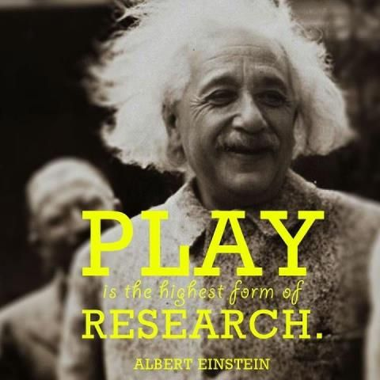

Slide 9
Behaviour and expectations
The first few weeks will be spent settling children in, setting expectations and creating a whole class ethos and culture.
Incredibly nurturing
We will celebrate children’s good behaviour and acts of kindness and helpfulness. (Have you filled a bucket today?)
We will give children Dojo points for good learning behaviours
There will be a Dino learner of the week
There is a daily phonics superstar certificate
Reading certificates and rocket display

Slide 10
Class dojo
Any learning you do at home please post to the profile as we will award Dojo points
Any messages will be sent through Dojo
You can message your class teacher on Dojo - It’s a great communication tool
Certificates

Slide 11
Parent Partnership
We want you to be very involved with your child’s Reception year!
You are your child’s first educator and know them best!
Open door policy.
Class Dojo
Newsletters
Please share with us anything you have done at home that means something to your child and we will share and celebrate it at school!
Stay and Play Sessions and workshops
Reading at home with your child is so important.
Children will bring home phonics sound fans and writing book to aid recognition and reading
Family projects might be sent home occasionally!

Slide 12
Classes
Fluid classes/ teachers
Working as a unit
Tailored curriculums

Slide 13


